Slide 1
Revised Officer Evaluation Reports 1 APR 14 Implementation
OVERVIEW MOD 1

Slide 2
Background
Senior Leader focus for Evaluation Review:
Re-establish the company grade box check
Reduce the frequency of reports
Establish and enforce rater accountability
Strengthens relationship to leadership doctrine
(ADP 6-22)
Incorporate ability to document, “data mine” and identify talent
Address the “one size may not fit all” assessment of different skills and competencies at different grades
Keep the OER relevant and adaptive
SECARMY guidance (9 Mar 11):
Ensure responsibilities are clearly defined and vested with appropriate individuals
Assess the usefulness of Academic Evaluation Reports
Identify clear standards to assist raters with drafting evaluation reports
Informed By:
36th and 37th CSA framing guidance
Other Services and Industry review
Officer Selection Board AARs
Profession of Arms Forum
OPMS CoCs and GOSCs
Army White Paper, The Profession of Arms
Army Leader Development Strategy
ADRP 6-22
OER remains the primary tool documenting officer performance and potential
Unclassified
Notes:
Revisions to the OER began back on 1 NOV 2011 when we re-instituted the company grade box check.
Since then, Senior leaders have been focused on a thorough review of the current evaluation to determine how it could be improved and made more relevant.
The changes that are coming have been socialized throughout various levels of the Army to include 4-Star Senior Leader Forums, GOSCs, and various Professional development organizations.
----------------------------
One of the first questions we are asked is when is the implementation date? 1 APR 2014 is when we will implement the new OER.
An EXORD was released 25 SEP 2013 through G3 channels tasking Senior Mission Commanders with giving HRC the dates desired for Mobile Training Teams to come to each Installation’s footprint.
Mobile Training Teams consisting of 21 Active Army, 14 National Guard, and 6 Army Reserve personnel will be trained here at Fort Knox 2-13 December. MTTs will train Army wide from 4 January until 28 March 2014.

Slide 3
OER CHANGES
Discourage creation of large senior rater populations (pooling)
Limits the use of Intermediate Raters
Supplementary Review by an Army Officer for non-Army Rating Chains
Assess performance based on leadership attributes and competencies
Clear delineation of responsibilities: Rater-Performance; Senior Rater-Potential
Four separate evaluation reports based on grade:
Company Grade (2LT-CPT & WO1-CW2)
Field Grade (MAJ-LTC & CW3-CW5)
Strategic Leaders (COL)
Brigadier General
Implement a Rater Profile for the Company and Field Grade Forms
Future Operational and Broadening Assignment Recommendations
Redefine Senior Rater box label techniques (Less than 50% Top Box for LTC and below; 24/25% split for COL report (requires profile re-start))
Support form realigned and mandatory for WO1-COL
Evaluation Entry System (EES) replaces AKO
Unclassified
Notes:
There are several major changes to the current OER.
New OER is effective 1 APR 14. There are no close-out reports required.
Which version of the report you use is Thru-date driven (prior to 1 APR 14 is the 67-9 using AKO—after 1 APR use 67-10 using the EES)
There is a clear delineation of responsibility between Raters and Sr Raters. Raters will only comment on “Performance” and Senior Raters will only comment on “Potential.” They can no longer comment on both.
There is no longer one OER used for all officers. Now, there are four different versions of the officer evaluation report specifically tailored toward similar grade plates. There is a Company Grade, Field Grade, Strategic Leader, and General Officer evaluation report.
Raters will now have a profile to manage and be limited to the number of top-box checks they can give. Like Sr Rater’s, they will only be able to give the top box check to less than 49%.
-COL report uses 2 managed top boxes (Multi-star Potential at 24%; Promote to BG at 25-49%) The sum of the top 2 boxes cannot exceed 49.9%
New regulatory guidance strengthens the “normal” line of supervision. An individual’s “immediate” supervisor will be the Rater and the Rater’s “Rater” will be the Senior Rater. Intermediate raters will now be limited to specialty branches such as Chaplains, JAG, etc.) Rating schemes will be approved one level up.
The new OER Support form is mandatory for all officers, Colonel and below. The new support form aligns with Army leadership doctrine and mirrors the Company Grade Officer evaluation report which will make writing evaluations easier.
If the senior rater is a U.S. Army officer (other than a general officer), a DA civilian, or SES member who is also serving as the rater and
there is no other U.S. Army officer in the chain of supervision to conduct a supplementary review, HQDA will perform an additional review.
(b) When there are no uniformed Army designated rating official for the rated Officer, a supplementary review will be performed by the first U.S.
Army officer above the senior rater in the organization or chain of supervision. This officer will be designated as the Uniformed Army Advisor
by the CDR establishing the rating chain and identified in the published rating chain.

Slide 4
Strengthening the Rating Chain
Develop regulatory guidance to strengthen rating chain accountability
The updated policy strengthens accountability within the members of a rating chain to maintain relationships that provide rated officers with leaders who have first-hand knowledge of their responsibilities, performance and potential.
Still allows commanders and senior leaders to be responsible for designating rating schemes / approved one level up (up to 3-Star HQ)
Intermediate Raters limited to special branches and dual supervisor situations
When there are no uniformed Army designated rating official for the rated Officer, a supplementary review will be performed by the first U.S. Army officer above the Senior Rater in the organization or chain of supervision:
Applies in Joint Environments
Applies where DoD and DA Civilians serve as Rater and Senior Rater
Applies in multi-national environments
Unclassified
Notes:
-The new AR 623-3 and DA Pam 623-3 will require that a Rated Officer’s “immediate”
supervisor will be the Rater and the Rater’s Rater will be the Senior Rater.
-Rating chains must be approved by the next higher headquarters up to the 3-star
Level in order to prevent pooling of officers.
-Intermediate Raters will now be limited to specialty branches and dual supervisory
situations such as JAG, chaplains etc and some aviation units where the Senior Rater
does not meet minimum table 2-1 Senior Rater rank requirements with regard to
warrant officers.)
(1) For OERs-
(a) If the senior rater is a U.S. Army officer (other than a general
officer), a DA civilian, or SES member who is also serving as the rater and
there is no other U.S. Army officer in the chain of supervision to conduct a
supplementary review, HQDA will perform an additional review.
(b) When there are no uniformed Army designated rating official for the
rated Officer, a supplementary review will be performed by the first U.S.
Army officer above the senior rater in the organization or chain of
supervision. This officer will be designated as the Uniformed Army Advisor
by the CDR establishing the rating chain and identified in the published
rating chain. When such a review is conducted and the reviewer determines
comments are necessary, the supplementary reviewer will prepare a memorandum
(when required) as an enclosure to the OER, as illustrated in figure 2-2.
The memorandum will comment on the accuracy and/or clarity of the completed
OER in accordance with this regulation. The comments will not include
evaluative statements about the rated officer or statements that amplify,
paraphrase, or endorse the comments and/or ratings of the rating chain
members. If there is no available U.S. Army officer or DA civilian above
the senior rater in the chain of command, the senior rater or his or her BN
and/or BDE S1 or administrative office will request an additional review by
HQDA (see fig 2-3).

Slide 5
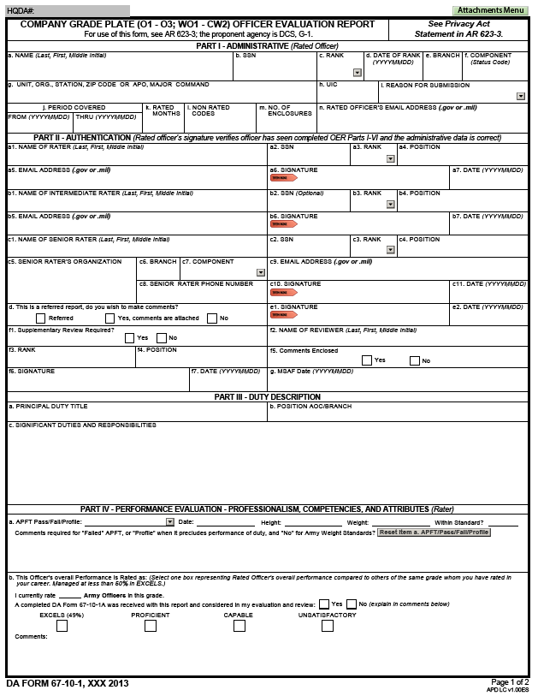
Company Grade Form Page 1
Administrative data remains consist with the old OER (67-9)
Highlights the need for a supplementary reviewer is required by updated AR / DA PAM 623-3
Addresses the completion of the multi-source assessment feedback
Rater’s comments pertaining to APFT move to page 1
Performance block checks and the Rater’s overall performance assessment
Up to 4 lines of text
Unclassified
Notes:
Here is an example of what the front side of the Company Grade form looks like. I show you for frame of reference; I will enlarge portions of the form on subsequent slides for discussion.
-The Company Grade evaluation will be used for 2LTs through CPT and WO1s through CW2.
You will note that the top half closely resembles the previous evaluation with the exception of a 360 MSAF date box which will replace the mandatory MSAF statement required on the previous OER form.
-Just below the duty description is a new APFT field. Raters now have the option to comments APFT if desired. Mandatory comments will be required for failures, profiles which preclude an officer from performing his/her duties, and failing to meet height/weight standards etc.
-The rater will indicate the number of officers he or she rates at that current grade and whether or not the OER Support Form was submitted to the rater.
-Below the APFT section is where the Rater will indicate his/her assessment based on duty performance against the Army officer peers that a Rater rates. You will notice that the names of the boxes have changed to “Excels,” “Proficient,” “Capable,” and “Unsatisfactory. Raters will be limited and not be able to give more than 49% in the “Excels”.
-The Rater’s comment block will allow for up to “four” lines of narrative text as is pertains to “PERFORMANCE” only.

Slide 6
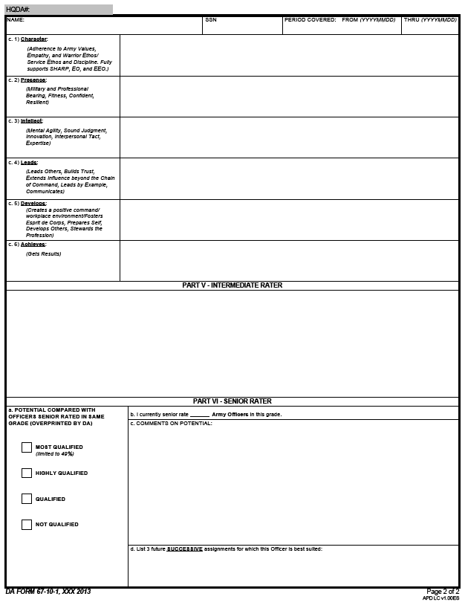
Company Grade Form Page 2
Focused on Attributes and Competencies (6-22)
Character
Presence
Intellect
Leads
Develops
Achieves
Intermediate Rater if applicable
Senior Rater block checks redefined to better identify leader potential
Most Qualified
Highly Qualified
Qualified
Not Qualified
Up to 4 lines of text
Up to 5 lines of text
Up to 5 lines of text
Unclassified
Notes:
-Page 2 of the Company Grade form is broken down into 6 different areas where the Rater will write up to “four” lines of narrative for the leadership attributes and competencies which align with the Support Form and ARDP 6-22 doctrine.
-The Intermediate Rater comments block will only be utilized for special branches that require dual supervision/advisory such as Chaplains and JAG officers etc. Intermediate Raters may enter up to “five” lines of narrative comments where they will address both “Performance” and “Potential.”
-The Senior Rater box checks will still have 4 box checks, though the names of the boxes have changed. The previous “Above Center of Mass” is now the “MOST QUALIFIED” which is still limited to LESS than 50%. The previous “Center of Mass” is now “Highly Qualified.” “Qualified” does not refer the report. Highly qualified is not constrained and it is important to note that “Qualified” is not adverse.
-The Senior Rater comments box looks similar but will be limited to “five” lines of narrative and the Senior Rater will only comment on “Potential.”
The future assignments field at the bottom of the form has changed. The SR Rater must now list three “future successive” assignments looking 3-5 years out.

Slide 7
Rater Profile
Maintain less than 50% of reports written by grade in the “Excels” box (for Raters of LTCs and below)
Flexibility - Raters have a “credit” of 3 in the “Proficient” box to start profile
OER profiles calculated based on date Rater “Locks” the profile
May not Lock profile earlier than 14 days prior to report THRU Date
OERs are due at HRC within 90 days after the thru date of evaluation
Senior Rater sequencing does not interfere with the Rater’s Locked profile
Maintain a working copy of your rater profile and monitor for accuracy
Profile calculators will be provided in EES for raters to use, which will assist with profile management
Unclassified
Notes:
-This slide covers some of the basic fundamentals of the Rater Managed Profile Technique.
-Raters of LTCs and below will now be accountable and limited to the number of “excels” block he/she can give. Raters must ensure that of the OERs submitted that he/she remains awards less than 50% of all OERs, by grade, as a top box Excels selection.
-Raters will receive a credit of 3 in the “Proficient” box which will allow a Rater the flexibility to render an “Excels” for not more than “two” of the first 3 reports. (Note: If a Rater submits 1 “Excels” then the math is 1 Excels combined with credit of 3 proficient which makes 1 “Excels” of 4 combined reports which equals 25% total for Excels – when a Rater submits 2 Excels combined with credit of 3 proficients, then the profile is 2 “Excels” of 5 reports which equals 40% Excels (which is less than 50% and within tolerance.)
-Profiles are calculated upon receipt at HQDA.
-Evaluations are still due to HRC NLT 90 days after thru date on the evaluation.
-Raters will have to manage a profile which is a Dash 2 (-2) and monitor it for accuracy. Leaders must share experiences on profile management with junior officers.
-The new Evaluation Entry System (EES) will have built in profile calculators to assist raters. It is extremely important to note that evaluations that are mailed in must be accounted for by rater until they have been received at HRC and calculated into an individual’s profile numbers. The Entry Evaluation System will prevent an individual from breaking their profile however it is only as accurate as what it can see. Mailing an eval is like writing a check. Your bank does not know you have written a check until it arrives get deducted.

Slide 8
Senior Rater Profile
Senior Rater profile established for Senior Raters of company and field grade officers
Maintain less than 50% of reports written by grade in the “Most Qualified” box (for raters of LTCs and below)
Flexibility - Raters may indicate Most Qualified for 1 of the First 4 reports
Senior Rater OER profiles are calculated based on date and time of receipt at HQDA;
once an evaluation is completed, the rater cannot retrospectively change mind on block check
OERs are due at HRC within 90 days after the thru date of evaluation
Maintain a working copy of your rater profile and monitor for accuracy
EES will have built in profile calculators. Profile calculators are provided for raters to use (example on next slide) available on Evaluation Webpage
Notes:
Senior raters must maintain less than 50% for all reports written on officers WO1-LTC in a single grade in the Most Qualified Box to retain the MOST QUALIFIED label at final processing.
A rule in AR 623-3 allows any one of the first four OERs written in any grade to be a Most Qualified, even though the percentage might exceed the 50% rule. After the first four reports are rendered, any OERs for a given grade must maintain an Most Qualified percentage less than 50%.
OER Senior Rater profiles are calculated based on date of receipt at HQDA. Multiple OERs received on the same day will profile as of DATE TIME OF receipt and will include HARD COPY (mailed or email copies) as of the synchronization date (day prior). If the rated officers name is not included in your profile numbers and his or her OER was not sent via EES, you may misfire.
OERs process and profile at HQDA in date of receipt order. An OER received today will not complete processing and profiling before one of the same rank and same senior rater that arrived last week.
The profile for any single grade may only be restarted if at least 3 OERs for the same grade have processed, senior raters obtain permission /authorization from their senior raters and at least one OER in this grade has already been documented as a misfire. The senior rater must notify HQDA Evaluations Systems Office (HQDA-ESO) and both must agree to the effective date and grade(s) for the restart.

Slide 9
Rater Box Check
Rater overall assessment of rated officer’s performance compared to officers in same grade
Limited to Company and Field Grade forms
e. This Officer’s Overall Performance is Rated as: (Select one box representing Rated Officer’s overall performance compared to others of the same grade whom you have rated in your career. Managed at less than 50% in EXCELS.) I currently rate____ Army Officers in this grade.
EXCELS
(49%)
EXCELS PROFICIENT CAPABLE UNSATISFACTORY
()
X
Comments:
Example Rater Label:
HQDA COMPARISON OF THE RATER’S PROFILE AND BOX CHECK AT THE TIME THIS REPORT PROCESSED
EXCELS
(49%)
PROFICIENT
()
R: RANK/GRADE NAME
SSN: xxx-xx-xxxx
TOTAL RATINGS:
RO: RANK SOLDIERS NAME
SSN: xxx-xx-xxxx
DATE:
RATINGS THIS OFFICER:
Comments:
Unclassified
Notes:
This slide depicts the box checks that a Rater can select with regard to the rated officer’s performance as compared to all of the officers the Rater has rated throughout his/her career.
-The bottom portion of this slide shows an example of the HQDA label that will be over-stamped on the OER once processed at HQDA. The label will contain the Rated Officer’s name, date the evaluation was submitted to HQDA, the number of ratings for this officer, and the total number of ratings for officers in this grade.

Slide 10
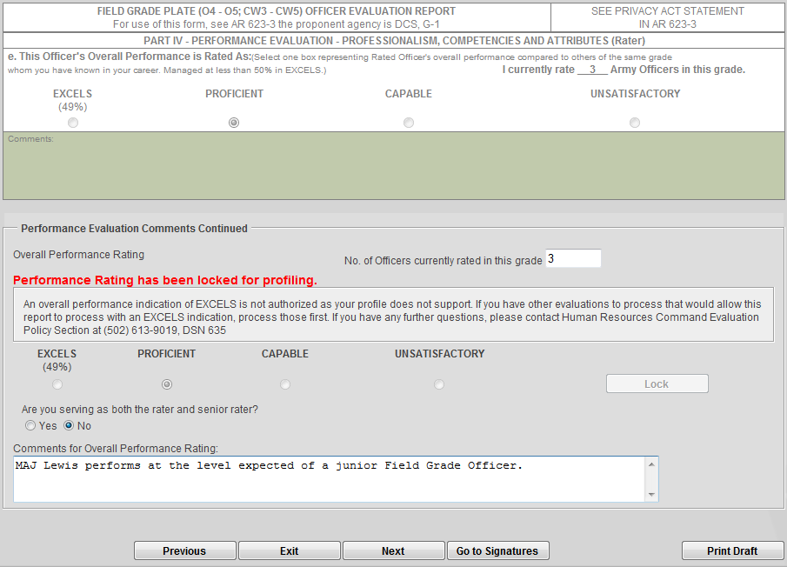
How to Lock the Rater Profile
Allows Raters to see their profile
Unclassified
Notes:
This slide shows a snapshot of what the “Rater” will see within the new Evaluation Entry System.
-After entering the Performance block comments , the Rater will select the appropriate overall performance block rating then will have to “lock” that rating.
-The system has a built in profile calculator which will not let you select an “Excels” block if your profile does not support it. If an individual’s profile does not support giving an “Excels” box check then the option will be grayed out and not allow you to select it.
-Once the rater “Locks” his/her box check, it cannot be unlocked by the rating official. If there is a need to make a change to the rater box check, the rater must contact HQDA and request an exeption to policy.

Slide 11
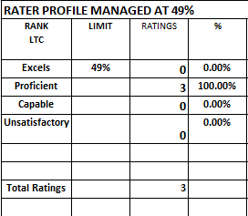
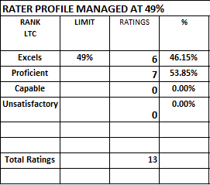
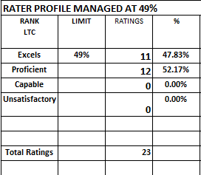
Rater Profile - 4 Box System
Profile Credit of 3 – By Grade
Profile Credit Start
After first 10 Reports with Credit
After first 20 Reports with Credit
Rater profile credit of 3 in Proficient Box. Profiles are counted by grade, not cumulative for all grades
Rater may submit:
6 of first 10 as Excels
Excels box must be less than 50% profile limitation
Rater may submit:
11 of first 20 as Excels
Excels cannot exceed the 50% profile limitation
Using a Profile Credit of 3: Minimal inflation in the “Excels” Box
Unclassified
Notes:
This slide depicts the Rater profile math using the 4 box system.
Each grade will receive a credit of 3 in the “Proficient” category.
Looking at the first diagram you can see where the rater has been credited with 3 in the “Proficient” category.
The second diagram shows how the math will add up after the first 10 evaluations have been submitted (13 evaluations factoring in the credit of 3). After submitting 6 evaluations with “Excels” and 7 with “Proficient” it will bring the rater’s profile to 46% in “Excels” which is within the LESS THAN 50% standard. The “Proficent” category will be at 53%.
The third diagram shows how the math will calculate after the first 20 reports have been submitted with a credit of 3 in “Proficient.” A rater can submit up to 11 evaluations with “Excels” and 12 with “Proficients” which will put the Rater’s “Excels” profile at 47.8% which is still within standard of being LESS THAN 50%.

Slide 12
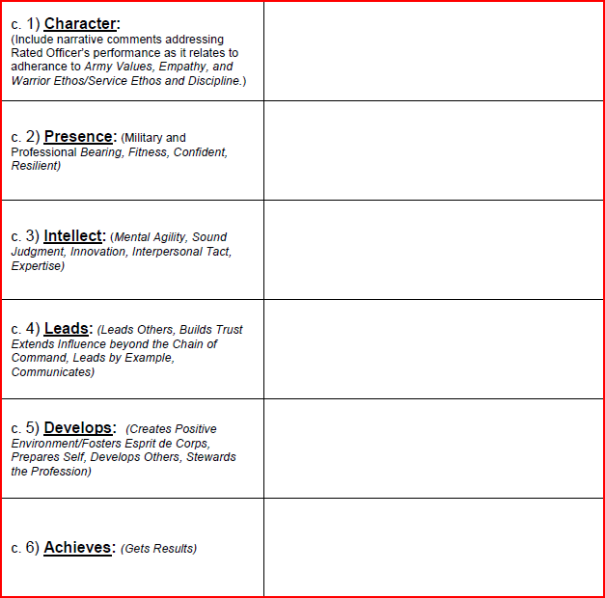
Rater Assessment: Company Grade Form
A true professional and leader; embodies the Army Values in all that he does. Bill tactfully instills discipline and the Warrior Ethos in his subordinates. He consistently uses sound, informed judgment.
Focused on core attributes and competencies in ADP 6-22
More prescriptive
Performance based assessment
Narrative only (4 lines per entry)
Mandatory entry for each Attribute/Competency
Encourages specific discussion with Rated Officer on desired traits
Displays confidence and enthusiasm while projecting a positive command presence that permeates his unit; evidenced by his company’s 275 APFT average, best in the brigade.
Comments on performance – not potential
Unclassified
Notes:
This slide depicts the rater assessment portion of the Company Grade OER.
-The Rater will assess the Rated Officer based on Performance as it pertains to the core attributes and competencies as outlined in the ADRP 6-22.
-The Rater will only comment on PERFORMANCE and will no longer mention potential. Commenting on potential is the sole responsibility of the Senior Rater.
-Comments for each attribute and competency block will be mandatory and Rater’s will have the ability to write up to 4 lines of narrative text in each comments block.

Slide 13
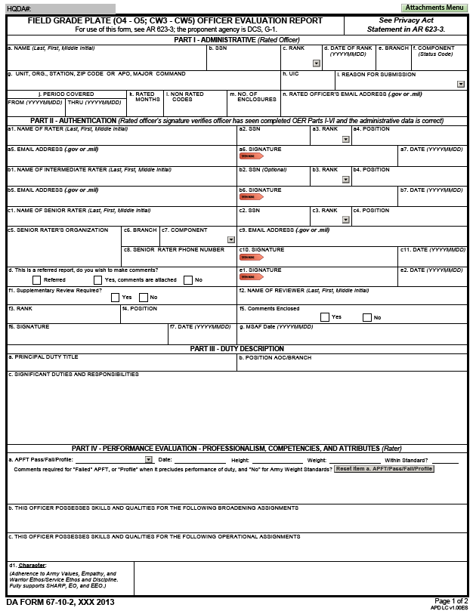
Field Grade Form O4/O5; CW3-CW5 Page 1
Administrative data remains consist with the CO Grade evaluation
Raters have the opportunity to comment on possible broadening and operational assignments
Attribute of Character is highlighted on the Field Grade Form
Unclassified
Notes:
This slide shows what page 1 of the Field Grade Form looks like.
-The administrative data in the top third of the form is the same as the Company Grade report.
There are two new assignments fields at the bottom of the page. The first is where the Rater can indicate up to three “Broadening” assignments best suited for the rated officer. The second is where the Rater may list the 3 “operational” assignments where the rated officer is best suited for. Ideally think 3-5 years out.
The last field at the bottom of the form is where the Rater will write up to 4 lines of narrative text commenting on Character.

Slide 14
Rater Recommended Assignments
(Field Grade and Strategic Level)
Field Grade Plate- Rater Recommended
Strategic Grade Plate- Rater Recommended
Unclassified
Notes:
-This slide shows close up portions of the Field Grade and Strategic grade reports where Raters MAY recommend potential “Broadening,” “Operational”, and “Strategic” assignments looking 3-5 years out.
-This data will assist Assignment and Career Managers in selecting the right officer for the right assignment.

Slide 15
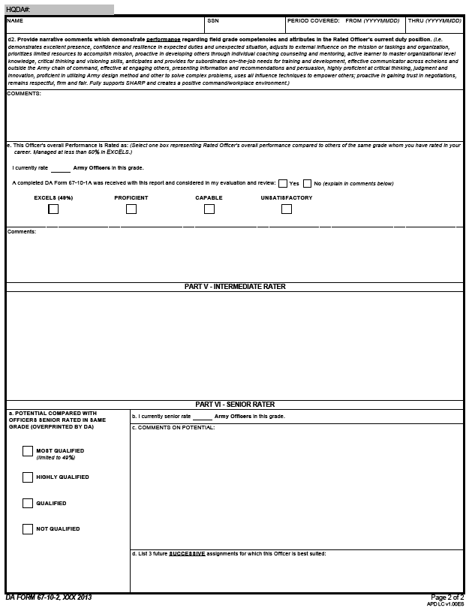
Field Grade Form O4/O5; CW3-CW5 Page 2
Rater comments on the Officer’s performance against the Attributes and Competencies during the rating period
Box checking philosophy remain consistent; less than 50% Excels
Rater’s overall performance is further codified in the Comments section
Up to 5 lines of text
Up to 4 lines of text
Up to 5 lines of text
Up to 5 lines of text
Unclassified
Notes:
-Raters will have up to 5 lines of narrative text which demonstrate “Performance” regarding Field Grade attributes and competencies as it relates to the Rated Officer’s duty description. (Note: Raters will not mention potential)
The Rater will indicate how many Army Officer he/she “currently” rates and indicate whether an OER Support Form was submitted to the Rater. The Rater will check the appropriate box based on overall performance based on all of the officers in that specific grade that he or she has rated.
-The Rater’s “Excels” box check is the only constrained box. It is limited to 49% or less.
Just below the Rater’s overall performance box check, the Rater has up to 4 lines of narrative text to comment on the Rated Officer’s overall performance as compared to everyone of that grade the rater has rated to date.
-Intermediate Raters will only be used for Special Branches and some Joint situations. They will have 5 lines of narrative text where they will comment on both performance and potential.
The Senior Rater portion is the same as on the Company Grade form. The Senior Rater will have up to 5 lines to comment on “potential” only, then list the 3 future successive assignments the officer is best suited for, looking 3-5 years out.

Slide 16
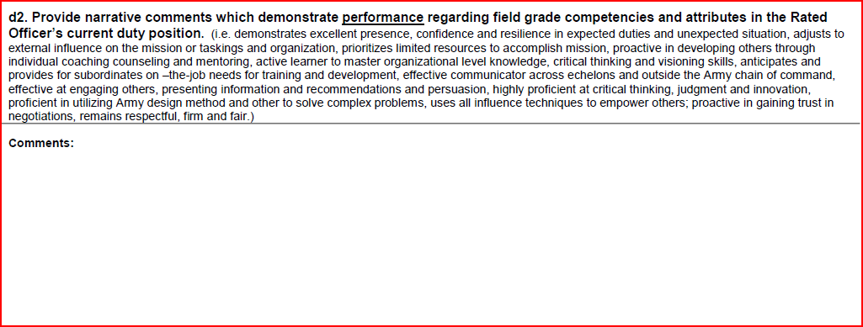
Rater Assessment: Field Grade Form
d2. Provide narrative comments which demonstrate performance regarding field grade competencies and attributes in the Rated Officer’s current duty position. (i.e. demonstrates excellent presence, confidence and resilience in expected duties and unexpected situation, adjusts to external influence on the mission or taskings and organization, prioritizes limited resources to accomplish mission, proactive in developing others through individual coaching counseling and mentoring, active learner to master organizational level knowledge, critical thinking and visioning skills, anticipates and provides for subordinates on –the-job needs for training and development, effective communicator across echelons and outside the Army chain of command, effective at engaging others, presenting information and recommendations and persuasion, highly proficient at critical thinking, judgment and innovation, proficient in utilizing Army design method and other to solve complex problems, uses all influence techniques to empower others; proactive in gaining trust in negotiations, remains respectful, firm and fair.)
Narrative comments focused on performance in line with field grade competencies and attributes
Limited to 5 lines of text
Performance based assessment; no comment on potential
Unclassified
Notes:
-This slide depicts the rater assessment portion of the Field Grade evaluation report. Policy guidance will direct that officers be assessed not only on professional performance but on the core competencies and attributes expected of Army leaders (particularly as it applies to medical and legal professionals). Raters will be limited to 5 lines of narrative comments.

Slide 17
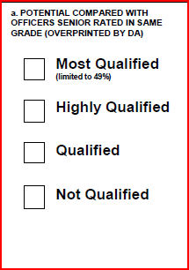
Senior Rater Box Check
Four box profile remains consistent with current system; provides more options for senior raters
Highly Qualified and Qualified enable greater stratification
Most Qualified becomes the control box (limited to less than 50%)
No restart of profile; no close-out reports
Continue to mask 2LT/1LT after promotion to CPT; WO1 after selection to CW3
MOST QUALIFIED: Strong potential for BZ and CMD; potential ahead of peers
HIGHLY QUALIFIED: Strong potential for promotion with peers
QUALIFIED: Capable of success at the next level; promote if able
NOT QUALIFIED: Not recommended for promotion
Box Check Assessment
= Current COM
Not Referred
Unclassified
Notes:
-Senior Raters will continue to have a 4 box check system they can use to assess Potential.
-The top 3 blocks are favorable. Each recommends promotion.
-Highlighted in yellow box to the right, it defines the level of stratification for potential and future promotion.
-Profile transfers for LTC and below. The New system will read from your existing SR profile, and continue to include any reports submitted using the 67-9 when providing the real-time SR profile.
Additionally, Senior Raters will receive a “Warning Label” if rendering a Most Qualified box will cause a misfire.
An official misfire (going over 49.9% in that rank) will calculate the SR profile against the Most Qualified box, but show a DA Label of Highly Qualified when the board reviews the OER.

Slide 18
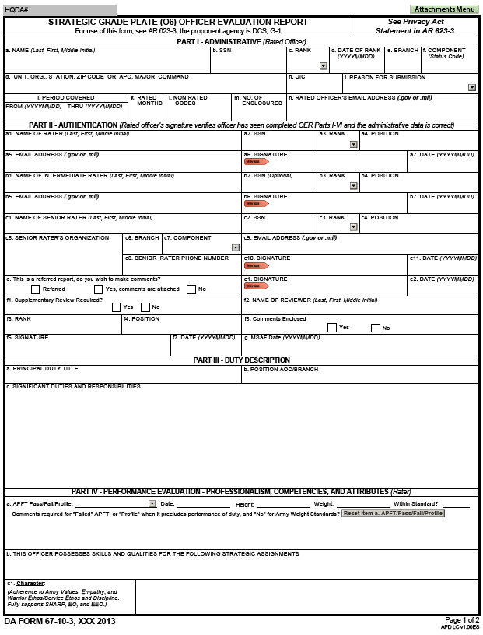
COL Report Page 1
Admin data mirrors Company and Field Grade forms
Raters will recommend future strategic assignments to assist talent managers in placing the Rated Officer into their next duty assignment
Unclassified
Notes:
-The front page of the Strategic Grade Colonel report mirrors the field grade report with one exception. Instead of recommending “Broadening” and “Operational” assignments, on the COL report Raters “may” provide up to 3 “Strategic” level assignments best suited for that officer.
-Raters will have up to 4 lines of narrative text to comment on character.

Slide 19
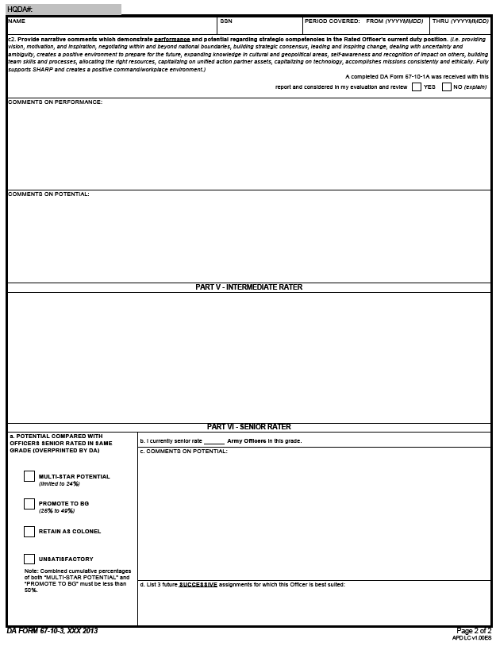
COL Report Page 2
Rater’s of COLs will comment on the Officer’s potential
Senior Rater box check labels change from Company and Field Grade Officer forms
Up to 5 lines of text
Up to 5 lines of text
Cumulative percentage must remain below 50%
Unclassified
Notes:
Because the math will change, Senior Raters of Colonels, will have their COL profile re-start on 1 APR 14 for reports rendered using the 67-10.. They will then be given a credit of 5 in “Retain as Colonels” which will allow immediate recognition of top performers.
-Unlike the Field Grade report, Raters of Colonels will have 5 lines of narrative to comment on Performance and an additional 5 lines of narrative to comment on Potential.
-The names of the box checks in the Senior Rater section have changed to better stratify top performers. There is a “Multi-Star” and “Promote to BG” block. Both are equivalent to the previous “Above Center of Mass.” The Multi-star potential block is limited to not more than 24%. The cumulative percentage of both Multi-star and Promote to BG cannot exceed 49%. (Note. A Senior rater can elect NOT to give any multi-star blocks and issue up to 49% for the Promote to BG block).
-There is a 3rd box, “Retain as Colonel” which is equivalent to a Center of Mass.

Slide 20
Senior Rater Box Check
No Rater “box check”
Rater narrative comments focused on performance and potential
Change Box Check Terminology and option of 24% and 25 - 49% limits (more restrictive than current system)
More clearly identifies the best compared to current system
Requires restart of COL population
Senior Rater will receive a “credit” of 5 to start profile in “Retain as Colonel” block
Senior Rater philosophy will best determine how to describe the rated officer’s General Officer Potential
a. POTENTIAL COMPARED WITH OFFICERS SENIOR RATED IN SAME GRADE (OVERPRINTED BY DA)
Two ACOM
Boxes
MULTI-STAR POTENTIAL
(Limited to no more than 24%)
Multi-Star limited to 24% of total reports
Promote To BG limited to 25 – 49.9% of total reports
MULTI-STAR POTENTIAL
(Limited to no more than 24%)
CUMULATIVE % Remains less than 50%
PROMOTE TO BG
(25% to 49%)
PROMOTE TO BG
(25% to 49%)
RETAIN AS COLONEL
UNSATISFACTORY
Note: Combined cumulative percentages of both “MULTI-STAR POTENTIAL” and “PROMOTE TO BG” will not exceed 49%
Unclassified
Notes:
Because the math will change, Senior Raters of Colonels, will have their COL profile re-start on 1 APR 14 for reports rendered using the 67-10.. They will then be given a credit of 5 in “Retain as Colonels” which will allow immediate recognition of top performers.
-Unlike the Field Grade report, Raters of Colonels will have 5 lines of narrative to comment on Performance and an additional 5 lines of narrative to comment on Potential.
-The names of the box checks in the Senior Rater section have changed to better stratify top performers. There is a “Multi-Star” and “Promote to BG” block. Both are equivalent to the previous “Above Center of Mass.” The Multi-star potential block is limited to not more than 24%. The cumulative percentage of both Multi-star and Promote to BG cannot exceed 49%. (Note. A Senior rater can elect NOT to give any multi-star blocks and issue up to 49% for the Promote to BG block).
-There is a 3rd box, “Retain as Colonel” which is equivalent to a Center of Mass.

Slide 21
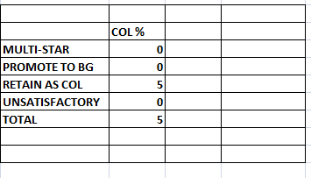
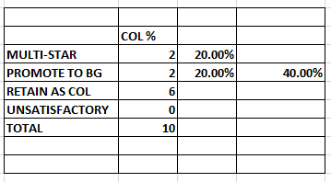
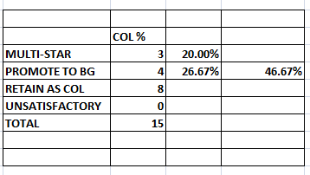
Profile Credit of 5 for Colonel Report
Profile Credit of 5
Profile Credit at Implementation
After first 5 Reports with Credit
After first 10 Reports with Credit
Senior Rater Limit:
No more than 24% for Multi-Star
No more than 25-49% for Promote to BG
Senior Rater may submit:
2 of first 5 reports as MULTI-STAR 24%
2 of first 5 as PROMOTE TO BG.
Top two boxes cannot equal (50%) cumulative profile limitation for the top two boxes
Senior Rater may submit:
3 of first 10 reports as MULTI-STAR 24%
4 of first 10 as PROMOTE TO BG.
Top two boxes cannot equal (50%) cumulative profile limitation for the top two boxes
Upon system restart, your profile will look like this.
Unclassified
Notes:
This slide shows what the math will look like once the Colonel profile has been reset and given a credit of 5 in the “Retain as Colonel” category.
-The second box shows what the profile will look like after the first 5 reports with credit of 5 factored in. A senior rater can give up to 2 “Multi-star” and 2 “Promote to BG.” The cumulative percentage of both Multi-star and Promote to BG is 40%.
The third box shows what the profile will look like after the first 10 reports with credit of 5 “Retain as Colonel” factored in. Three of the first 10 reports can be given a “Multi-star” and 4 of the first 10 can be “Promote to BG.” The combined total of Multi-star and Promote to BG is 46% which is just below the maximum percentage of 49%.

Slide 22
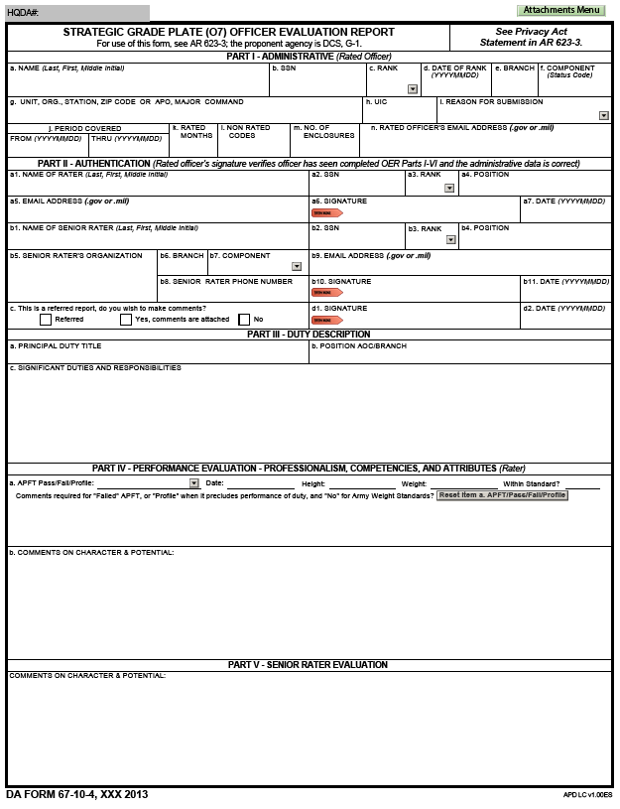
BG Report
1-Page OER for BGs
Rater and Senior rater both comment on character and potential
No rater and senior rater box check
Processes thru HRC to Officers Army Military Human Resource Record
Unclassified
Notes:
This slide shows an example of the Brigadier General evaluation report. It is a one page evaluation report.
-Raters and Senior Raters will comment on both “Character” and “Potential.”
-Like the other three evaluation reports, this evaluation report will also be processed through HRC and ultimately to the Officer’s OMPF.

Slide 23
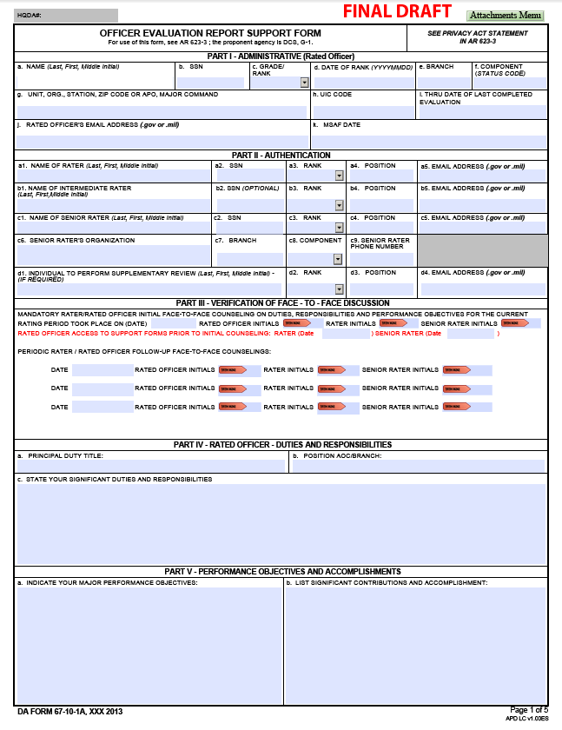
OER Support Form Page 1
MILPER 13-349 released 3 DEC 13
Data transferable between the support and evaluation forms within EES
Facilitates the rater’s ability to easily complete future OERs
Performance based counseling tool
Ties performance objectives to measureable accomplishments
Unclassified
Notes:
OER support form is mandatory for use for Rated Officers in the Grade of O6 and below.
Support form will be available to the field for use 4 DEC 13 in a PDF—this allows the Senior Raters and Raters of Officers to complete their support forms and begin to counsel using the mandatory document.

Slide 24
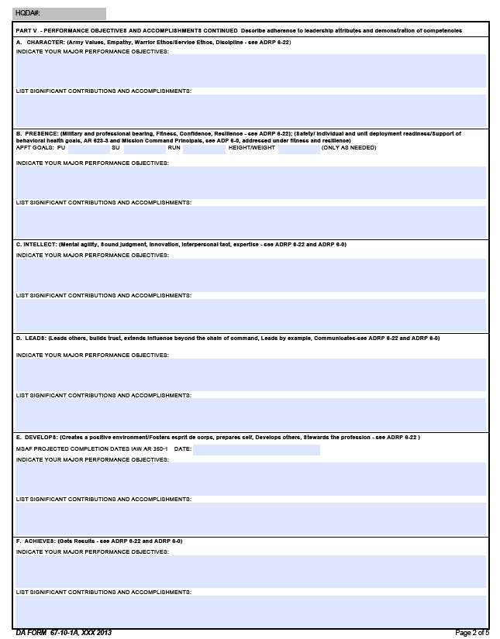
OER Support Form Page 2
Nested with the current leadership doctrine (ADRP 6-22)
Character
Presence
Intellect
Leads
Develops
Achieves
Pages 3-5 of the form contain instructions to assist
Unclassified

Slide 25
Evaluation Entry System (EES)
HTTPS:// EVALUATIONS.HRC.ARMY.MIL
EES is the revised web-based tool in development at HRC, which will be used to complete and submit evaluations.
EES will consolidate AKO MyForms wizard, IWRS, excel profile calculators, etc.
Benefits of EES:
Enhanced wizard to guide rating chain and Human Resource professionals in preparing the evaluation
Multi-pane dashboard allows user to view data input and form simultaneously
Built-in tool to view and manage Rater and Senior Rater profiles
Provides quick reference to AR 623-3 and DA PAM 623-3
Eliminates accessing multiple systems and consolidates evaluation tools to one system
Does not delay evaluation processing due to rater profile “misfires” (automatic downgrade)
Unclassified
Notes:
The Evaluation Entry System is an HRC web-based system that users will use to complete and submit evaluations to HQDA. EES has numerous benefits to offer.
-EES consolidates AKO MyForms, IWRS, and profile calculators which will eliminate the need to access multiple systems to retrieve data.
-EES will require users to enter data through an enhanced wizard which will prevent most common errors. There is a split screen pane in EES which will allow users to see wizard and the form on same screen.
-Profile calculators are built into the system and raters and senior raters will be able to monitor their profile in real time. Raters will only be able to select an “Excels” rating if their profile supports it. Senior Raters will still have to sequence their reports
-MTTs and VTC/DCO training sessions scheduled to begin in NOV

Slide 26
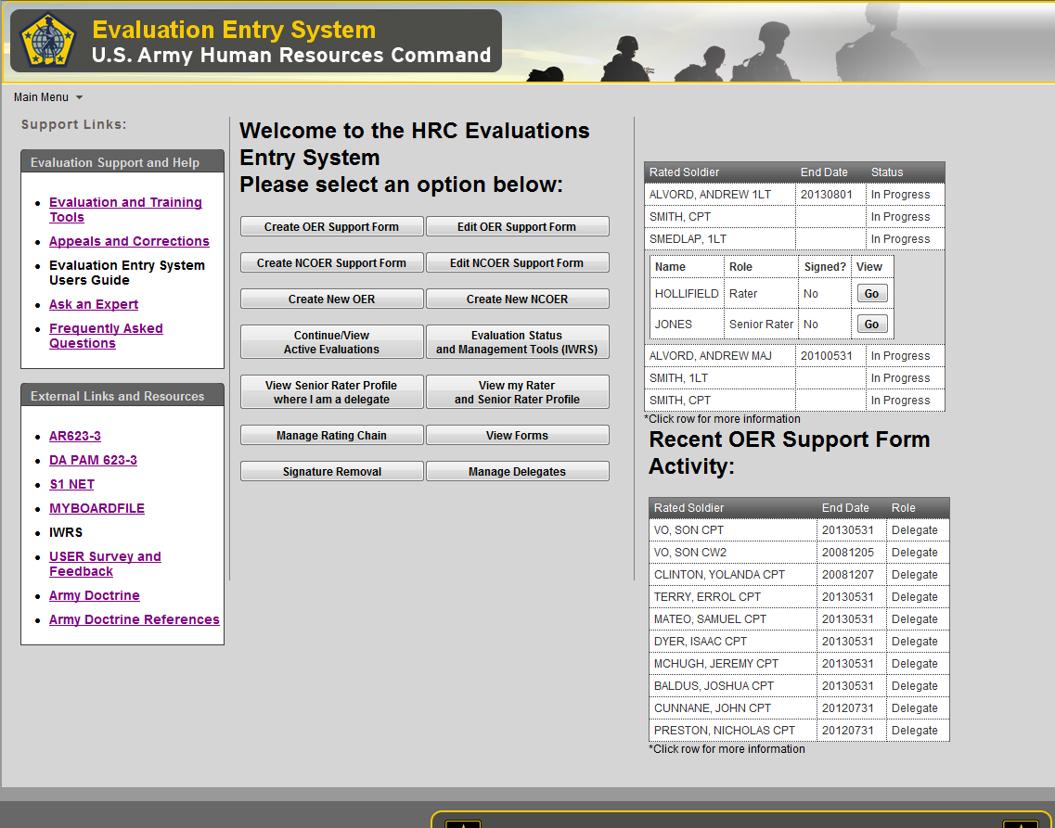
Evaluation Entry System (EES) Landing Page
https://evaluations.hrc.army.mil
Unclassified
Notes:
-This slide shows what the Evaluation Entry System landing page looks like when users log into the system.
-From this landing page, users can select from a variety of options depending on what they desire to do. Users can create a Support Form, Evaluation, or review their rater and senior rater profile.
-Some of the button links will be in development and not yet operational.
-On the left you will users will have access to useful links and resources.
-On the right users will see recent OER activity associated to that user.

Slide 27
Questions
Unclassified

Slide 28
Backup Data

Slide 29
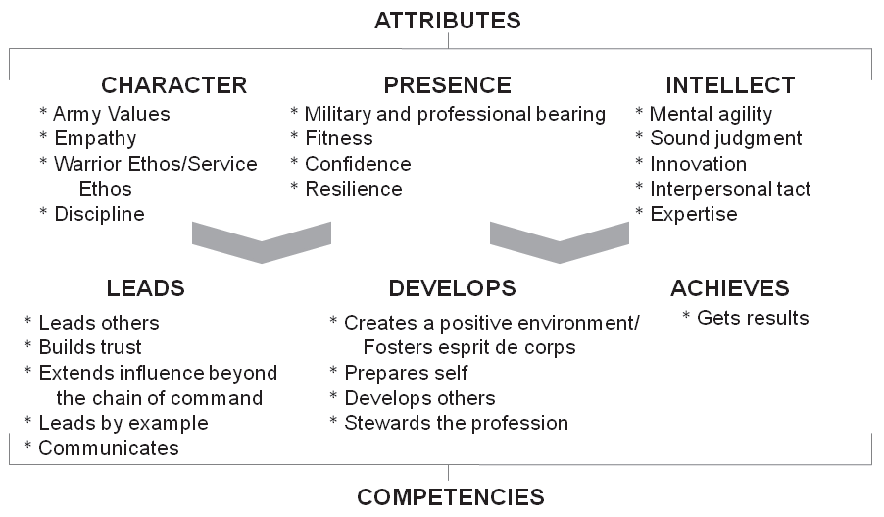
Army Leadership Requirements
ADRP 6-22 AUG 2012 Figure 1-1. The Army leadership requirements model
Unclassified
Notes:
1-27. The Army exists to serve the American people, to protect enduring national interests and to fulfill the
nation’s military responsibilities. This requires values-based leadership, impeccable character, and
professional competence. The requirements are for leaders at all levels and are common to all cohorts. The
model informs leaders of the enduring capabilities needed regardless of the level of leadership, mission, or
assignment. All model components are interrelated and relate to the Department of Defense (DOD) civilian
leader development framework established by DODI 1430.16 (see figure 1-1).
1-28. The model’s components center on what a leader is (attributes) and what a leader does
(competencies). The leader’s character, presence, and intellect enable the leader to master the core leader
competencies. The Army leader is responsible to lead others; to develop the environment, themselves,
others, and the profession as a whole; and to achieve organizational goals.
1-29. Effective leadership and leader development require mutual recognition and acceptance of leader and
follower roles. Leadership is a reciprocal influence process between leaders and followers.

Slide 30
O-4 Broadening Experiences
Functional
ASCC
OPS/Plans Officer
WFF Chief
ASA/DCS
Asst XO
ADC
Division Chief (BR/ FA Specific)
USACE
DCO
ARCIC WFF Chief/Manager
AMC
COCOM LNO
OCLL LNO
CTC
Senior OC-T
JRTC Village Stability Director
AC/RC OC-T
DA/ASA/DCS
Division Chief
Director.
AWG (Forward Ops Chief)
TRADOC
CAC WFF Chief/SME
Institutional
CIG Action Officer
SA/CSA/ASA/DCS
Asst XO
ADC
Special Assistant
Strategic Plans Officer
AOC Action Officer
Speech writer
DA Staff Asst XO
HRC Branch Chief
AWC Staff
CGSC Faculty
Recruiting Command HQs (BDE XO, S3)
TRADOC HQs (LNO, ARCIC Chief, DIV Chief)
CAC
DIV Chief
Doctrine Dev
CDID Project Officer
Exercise Officer
Action Officer
ASCCs
OPS/Plans Officer
Cadet Command HQs
USAREC HQs
1st Army/5th Army Staff
FORSCOM HQs
Academia & Civilian Enterprise
Fellowships
PMS/APMS
USMA Faculty/Staff
Directorate
BTO
Training With Industry
JIIM
AIDE TO PRES/VP
COCOM/Joint Staff Asst XO
COCOM HQs Commandant
UN Staff Officer
DCE Region OPS Officer
DOS Defense Trade Analyst
OSD
Analyst
Planner
Emergency Ops officer Assistant
Watch Officer
COCOM/Joint Staff
Analyst
OPS/PLANS/JOC
WFF Chief
Chiefs/Liaisons
IA Liaisons
Watch Officer
NORTHCOM Regional Support Chief
State IG
OCLL Liaison
Sister Service Faculty
TRADOC Sister Service LNO
Transition Team
Military Observer
Allied Program Manager
NGB Staff
CGSC IA Fellow
Unclassified

Slide 31
O-5 Broadening Experiences
Functional
ASCC
OPS/Plans Officer
WFF Chief
ASA/DCS
Asst XO
ADC
Division Chief (BR/ FA Specific)
USACE
DCO
ARCIC WFF Chief/Manager
AMC
COCOM LNO
OCLL LNO
CTC
Senior OC-T
JRTC Village Stability Director
AC/RC OC-T
DA/ASA/DCS
Division Chief
Director.
AWG (Forward Ops Chief)
TRADOC
CAC WFF Chief/SME
Institutional
CIG Action Officer
SA/CSA/ASA/DCS
Asst XO
ADC
Special Assistant
Strategic Plans Officer
Speech writer
DA Staff Asst XO
HRC Branch Chief
AWC Staff
CGSC Faculty
Recruiting Command HQs (BDE XO, S3)
TRADOC HQs (LNO, ARCIC Chief, DIV Chief)
CAC
DIV Chief
Doctrine Dev
ASCCs
OPS/Plans Officer
Cadet Command HQs
USAREC HQs
1st Army/5th Army
IMCOM
CSA Strategic Studies Group
Army Strategic Planner
FORSCOM HQs
Academia & Civilian Enterprise
Fellowships
PMS/APMS
USMA Faculty/Staff
RTO
Instructor
HQs/Staff
AWC Faculty
CGSC Faculty
JIIM
AIDE TO PRES/VP
COCOM/Joint Staff Asst XO
COCOM HQs Commandant
JCS Regional COCOM Desk Chief
OSD
Analyst
Planner
Strategist
Desk Chief
POL-MIL Planner
Military Assistant
Speechwriter
COCOM/Joint Staff
Division Chief
TNG/Readiness
OPS/PLANS/JOC
WFF Chief
Chiefs/Liaisons
IA Liaisons
NORTHCOM Regional Support Chief
State IG
OCLL Liaison
Sister Service Faculty
TRADOC Sister Service LNO
Transition Team
Military Observer
Allied Program Manager
NGB Staff
Unclassified

Slide 32
O-6 Broadening Experiences
Functional
ASCC
Division Chief
Red Team
OPS
Plans
IG
ASA/DCS
XO
Mil Assistant
Division Chief (BR/ FA Specific)
USACE
DCO
TRADOC Capabilities Mgr
AMC
Command Directors
PM
COS
XO
CTC COG
DA/ASA/DCS
Division Chief
Director.
Institutional
HRC CIG Chief
SA/CSA/ASA/DCS
XO
Mil Assistant
Division Chief (BR/ FA Specific)
DA Staff XO
HRC DIV Chief
CAC Director
AWC Director
CGSC Faculty
Recruiting Command HQs
TRADOC HQs
CAC Director
CAL
COIN
DTAC
SAMS
ASCCs
Division Chief
Cadet Command HQs
USAREC HQs
1st Army/5th Army
IMCOM
CSA Strategic Studies Group
Army Strategic Planner
FORSCOM HQs
Academia & Civilian Enterprise
SSC Fellowships
PMS
USMA Faculty/Staff
AWC Faculty
CGSC Faculty
SAMS Faculty
JIIM
AIDE TO VP
COCOM/Joint Staff XO
JCS Regional COCOM Desk Chief
OSD
Analyst
Planner
Strategist
Desk Chief
POL-MIL Planner
Military Assistant
COCOM/Joint Staff
Division Chief
TNG/Readiness
OPS/PLANS
IG
Special OPS Chiefs/Liaisons
IA Liaisons
DOS Desk Chief
AWC Director Joint Multi-national studies
CAC Joint Allied Studies
Defense Coordination Officer
State IG
OCLL Director/Liaison
ALSA Director
Sister Service Faculty
Allied PM Foreign Mil Sales
DISA DIV Chief
Unclassified

Slide 33
O-3 Broadening Experiences
Functional
ASCC
OPS/Plans Officer
WFF Chief
CTC
OC-T
AC/RC
OC-T
TRADOC
SGL
Training/Ops officer
INSCOM
G2 Watch Officer
Institutional
CIG Action Officer
SA/CSA/ASA/DCS
ADC
Special Assistant
HRC
Assignment Officer
HQs
TRADOC
Ops Officer
Analyst
CAC
Doctrine Dev
Project Officer
Officer
Action Officer
ASCCs
OPS/Plans Officer
USAREC
Staff
Company CMD
Academia & Civilian Enterprise
Fellowships
ACS
Training with Industry
APMS
USMA Faculty/Staff
TAC
Instructor
JIIM
JCS Intern
PEOC Watch Officer
OSD
Watch Officer
Transition Team
Unclassified

Slide 34
Rater Box Check Defined
Excels:
Results far surpass expectations. The officer readily (fluently/naturally/effortlessly) demonstrates a high level of the all attributes and competencies. Recognizes and exploits new resources; creates opportunities. Demonstrates initiative and adaptability even in highly unusual or difficult situations. Emulated; sought after as expert with influence beyond unit. Actions have significant, enduring, and positive impact on mission, the unit and beyond. Innovative approaches to problems produce significant gains in quality and efficiency.
Proficient:
Consistently produces quality results with measurable improvement in unit performance. Consistently demonstrates a high level of performance for each attribute and competency. Proactive in challenging situations. Habitually makes effective use of time and resources; improves position procedures and products. Positive impact extends beyond position expectations.
Capable:
Meets requirements of position and additional duties. Capable of demonstrating Soldier attributes and competencies and frequently applies them; Actively learning to apply them at a higher level or in more situations. Aptitude, commitment, competence meets expectations. Actions have a positive impact on unit or mission but may be limited in scope of impact or duration.
Notes:
Excels:
Results far surpass expectations. The officer readily (fluently/naturally/effortlessly) demonstrates a high level of the all attributes and competencies. Recognizes and exploits new resources; creates opportunities. Demonstrates initiative and adaptability even in highly unusual or difficult situations. Emulated; sought after as expert with influence beyond unit. Actions have significant, enduring, and positive impact on mission, the unit and beyond. Innovative approaches to problems produce significant gains in quality and efficiency.
Proficient:
Consistently produces quality results with measurable improvement in unit performance. Consistently demonstrates a high level of performance for each attribute and competency. Proactive in challenging situations. Habitually makes effective use of time and resources; improves position procedures and products. Positive impact extends beyond position expectations.
Capable:
Meets requirements of position and additional duties. Capable of demonstrating Soldier attributes and competencies and frequently applies them; Actively learning to apply them at a higher level or in more situations. Aptitude, commitment, competence meets expectations. Actions have a positive impact on unit or mission but may be limited in scope of impact or duration.

Slide 35
Rater Profile Management
Rater profile established for raters of company and field grade officers
Maintain less than 50% of reports written by grade in the “Excels” box (for raters of LTCs and below)
Flexibility - Raters have a “credit” of 3 in the “Proficient” box to start profile
Rater OER profiles calculated based on Profile LOCK date as evidenced by “LOCKING” the profile indication (Locking as a Rater is the same as signing and sending to HQDA for a Senior Rater); once an indication of performance is LOCKED, the rater cannot retrospectively change mind (undo) on block check without HQDA exception to policy.
LOCKING cannot be completed earlier than 14 days before the THRU Date on the Evaluation.
OERs are due at HRC within 90 days after the thru date of evaluation
Maintain a working copy of your rater profile and monitor for accuracy
EES will have built in profile calculators. This profile calculator is your profile. It does not predict your plans. Profile calculators are provided for raters to use (example on next slide) are available on the Evaluation Webpage at HRC.
HRC will explore an automated “Profile Predictor” for future release.
16
Notes:
On this slide you’ll see some of the basic fundamentals of the new Rater Managed Profile Technique for raters of LTCs and below.
The Managed Profile Technique ensures raters can have confidence that other Raters are not gaining an advantage and that they are still able to give their best officers a good rating without hurting other.
Of course, the bottom line of the technique is that Raters must keep less than 50% of all OERs written, separated by grade, as a top box “Excels”.
HRC will apply a credit of 3 in “Proficient” once the profile is started.
The rater cannot mention the box check in any way as a means to ‘beat” the restriction. The rater cannot say: “if I had an Excels box to give”--- The rater cannot go back and “retrospectively” change the block check either. The profile is calculated upon rater’s LOCKING the report in EES.
OERs are due at HRC within 90 days of Thru date on report, so plan accordingly. EES will assist raters and senior raters with profile management, but raters can always keep a separate tracker/calculator that I will show you later.

Slide 36
Rater Managed Profile Labeling Rules
Rule #1: If the Rater checks “Proficient” box, then the report is always labeled “Proficient”
Rule #2: If the Rater checks “Capable” or “Unsatisfactory” box, then the report is always respectively labeled “Capable” or “Unsatisfactory”
- The sum of “Proficient,” “Capable,” and “Unsatisfactory” box checks should always be greater than 50% of total ratings
Rule #3: If the Rater checks “Excels” box and rater’s use of “Excels” is less than 50%, then the report is labeled “Excels”
- An entry of “Excels” will only be accepted if the mathematical result of the entry is less than 50% of the total number of reports rendered in that grade.
Rule #4: MISFIRE – “If the Raters checks the “Excels” box and rater’s profile is equal to or greater than 50%, then the report is labeled “Proficient" and the rater is charged with Excels.
Note: Online Evaluation completion will not allow Rater Misfires.
Notes:
Similar to how the current senior rater box check indication receives an HQDA label, the rater section will receive a label.
There are four rules HRC uses in labeling reports.
Rule #1: If a rater checks the “Proficient” box, then the label is “Proficient”.
Rule #2: If the rater checks “Capable” or “Unsatisfactory” box, then the report will be labeled as indicated on the form.
Rule #3: If the rater checks “Excels” and the rater’s profile (total number of “Excels” given in that grade divided by the total number of reports rendered in that grade) remains less than 50% including the current report, then the report will receive an “Excels” label.
Rule #4: A MISFIRE occurs when the rater checks “Excels”, but the rater’s profile is 50% or higher, then the report is labeled “Proficient”. The Rater is still charged with an “Excels”.
NOTE: Rule #4 is has a greater risk of occurring for mailed in or emailed reports to HQDA – The online entry system will prevent raters and prompt senior raters when checking blocks so MISFIRE situations should be minimal.

Slide 37
Example Rater Profile Calculator/Tracker
Will be available thru Evaluation Entry System Website
16
Notes:
Instructions for Rater Profile Management Calculator
This worksheet is designed to assist raters in keeping track of ratings rendered under the Officer Evaluation Entry System using DA Form 67-10. This unofficial worksheet should mirror information found on the profile report. It is available thru Evaluation Entry System Website www.evaluations.hrc.army.mil
Raters must maintain a separate worksheet for each rank, for the ranks of WO1, CW2, CW3, CW4, 2LT, 1LT, CPT, MAJ, and LTC. The rater will have one combined profile for each component: Active, USAR, and ARNG are not separate. Promotable officers serving in positions authorized at the promotable grade are profiled at the higher grade by entering a rank with (P) in Part Ic on the OER.
This is an unofficial worksheet, which may be modified to meet individual needs. Instructions for columns on the worksheet follow:
1. On the correct rank TAB at bottom of sheet, enter the Ratee’s Name, Type, and Date of Evaluation.
2. Enter a one in the corresponding Box Checks (grey box) column. You see a credit of 3 in Proficient Box to allow Raters some flexibility on issuing Excels for initial reports.
3. Annotate the box check the Rater made on the OER in the Profile (green box) column by adding a “1” to the respective box and carry the balances down from above. For computing and profiling purposes Proficient, Capable, and Unsatisfactory box checks are totaled, then the number of Excels issued is divided by the total number of reports completed to get % Excels (must remain under 50%). The total column (in yellow) calculates the total number of Evals completed for that rank. Information should be verified with HRC (by reviewing EES periodically).
4. Enter date due to HRC (forecast 90 days after thru date of evaluation)
5. Enter the actual date completed at HRC (verify in EES).
6. Total Excels % calculates number of Excels at far right of the sheet (tan), which must maintain less than 50%.
POC: OER Profile Policy questions. Evaluation Systems Office, USA HRC, (502) 613-9019 (DSN: 983), usarmy.knox.hrc.mbx.tagd-eval-policy@mail.mil.

Slide 38
Rater Profile Credit
Profile Credit of 3 – By Grade
Profile Credit Start
After first 10 Reports with Credit
After first 20 Reports with Credit
Rater profile credit of 3 in Proficient Box. Profiles are counted by grade, not cumulative for all grades
Rater may submit:
6 of first 10 as Excels
Excels box must be less than 50% profile limitation
Rater may submit:
11 of first 20 as Excels
Excels cannot exceed the 50% profile limitation
Notes:
This slide shows how the rater profile credit of 3 in “Proficient” effects the rater’s profile early on. The first chart shows the credit by rank. The credit counts towards total reports rendered. The second chart show what the rater’s profile looks like after rendering 10 additional reports with 6 being “Excels” yet the profile remains under 50% with the 3 credits. As the rater’s profile matures the credit has less impact, which is why we say the credit assists rater’s early on with immature profiles.

Slide 39
Senior Rater Profile
LTC & Below
CURRENT
 | #RATINGS | Rating% | % Limit
ABOVE CENTER OF MASS | 4 | 44.44% | <50%
CENTER OF MASS | 5 | 55.56% | Unlimited
BELOW CENTER OF MASS RETAIN | 0 | 0.00%
BELOW CENTER OF MASS (DNR) | 0 | 0%
TOTAL | 9 | 100%
FUTURE
 | #RATINGS | Rating% | % Limit
MOST QUALIFIED | 4 | 44.44% | <50%
HIGHLY QUALIFIED | 5 | 55.56% | Unlimited
QUALIFIED | 0 | 0.00%
NOT QUALIFIED | 0 | 0%
TOTAL | 9 | 100%
Migrates to new system
COL
CURRENT
 | #RATINGS | Rating% | % Limit
ABOVE CENTER OF MASS | 1 | 12.50% | <50%
CENTER OF MASS | 5 | 62.50% | Unlimited
BELOW CENTER OF MASS ® | 2 | 25.00%
BELOW CENTER OF MASS (DNR) | 0 | 0%
TOTAL | 8 | 100%
FUTURE
 | #RATINGS | Rating% | % Limit
MUTLI-STAR | 0 | 0.00% | <24.0%
PROMOTE TO BG | 0 | 0.00% | 25-49%
REATIN AS COL | 5 | 100.00% | Unlimited
UNSATISFACTORY | 0 | 0%
TOTAL | 5 | 100%
Profile Restart for reports after 1APR14
Unclassified
Notes:
This slide depicts what your senior rater profiles will look like on 1 APRIL 14.

Slide 40
Senior Rater Profile Calculator
WO1-LTC
16
Notes:
Instructions for Rater Profile Management Calculator
This worksheet is designed to assist raters in keeping track of ratings rendered under the Officer Evaluation Entry System using DA Form 67-10. This unofficial worksheet should mirror information found on the profile report.
Raters must maintain a separate worksheet for each rank, for the ranks of WO1, CW2, CW3, CW4, 2LT, 1LT, CPT, MAJ, and LTC. The rater will have one combined profile for each component: Active, USAR, and ARNG. Promotable officers serving in positions authorized at the promotable grade are profiled at the higher grade by entering a rank with (P) in Part Ic on the OER.
This is an unofficial worksheet, which may be modified to meet individual needs. Instructions for columns on the worksheet follow:
1. On the correct rank TAB at bottom of sheet, enter the Ratee’s Name, Type, and Date of Evaluation.
2. Enter a one in the corresponding Box Checks (grey box) column. You see a credit of 3 in Proficient Box to allow Raters some flexibility on issuing Excels for initial reports.
3. Annotate the box check the Rater made on the OER in the Profile (green box) column by adding a “1” to the respective box and carry the balances down from above. For computing and profiling purposes Proficient, Capable, and Unsatisfactory box checks are totaled, then the number of Excels issued is divided by the total number of reports completed to get % Excels (must remain under 50%). The total column (in yellow) calculates the total number of Evals completed for that rank. Information should be verified with HRC (by reviewing EES periodically).
4. Enter date due to HRC (forecast 90 days after thru date of evaluation)
5. Enter the actual date completed at HRC (verify in EES).
6. Total Excels % calculates number of Excels at far right of the sheet (tan), which must maintain less than 50%.
POC: OER Profile Policy questions. Evaluation Systems Office, USA HRC, (502) 613-9019 (DSN: 983), usarmy.knox.hrc.mbx.tagd-eval-policy@mail.mil.

Slide 41
Senior Rater Profile Calculator COL
16
Notes:
Instructions for Rater Profile Management Calculator
This worksheet is designed to assist raters in keeping track of ratings rendered under the Officer Evaluation Entry System using DA Form 67-10. This unofficial worksheet should mirror information found on the profile report.
Raters must maintain a separate worksheet for each rank, for the ranks of WO1, CW2, CW3, CW4, 2LT, 1LT, CPT, MAJ, and LTC. The rater will have one combined profile for each component: Active, USAR, and ARNG. Promotable officers serving in positions authorized at the promotable grade are profiled at the higher grade by entering a rank with (P) in Part Ic on the OER.
This is an unofficial worksheet, which may be modified to meet individual needs. Instructions for columns on the worksheet follow:
1. On the correct rank TAB at bottom of sheet, enter the Ratee’s Name, Type, and Date of Evaluation.
2. Enter a one in the corresponding Box Checks (grey box) column. You see a credit of 3 in Proficient Box to allow Raters some flexibility on issuing Excels for initial reports.
3. Annotate the box check the Rater made on the OER in the Profile (green box) column by adding a “1” to the respective box and carry the balances down from above. For computing and profiling purposes Proficient, Capable, and Unsatisfactory box checks are totaled, then the number of Excels issued is divided by the total number of reports completed to get % Excels (must remain under 50%). The total column (in yellow) calculates the total number of Evals completed for that rank. Information should be verified with HRC (by reviewing EES periodically).
4. Enter date due to HRC (forecast 90 days after thru date of evaluation)
5. Enter the actual date completed at HRC (verify in EES).
6. Total Excels % calculates number of Excels at far right of the sheet (tan), which must maintain less than 50%.
POC: OER Profile Policy questions. Evaluation Systems Office, USA HRC, (502) 613-9019 (DSN: 983), usarmy.knox.hrc.mbx.tagd-eval-policy@mail.mil.

